Slide 1
Airline business investment opportunities
Project Week 3 - Data Thieves
Constanze Krüger, Franclim Cardozo, Luís Saúde

Slide 2

Please fasten your seat belts,
we are about to take off !
Notes:
We are a new airline entering the market and finding the list of destinations that are more profitable and with lower flight offers

Slide 3
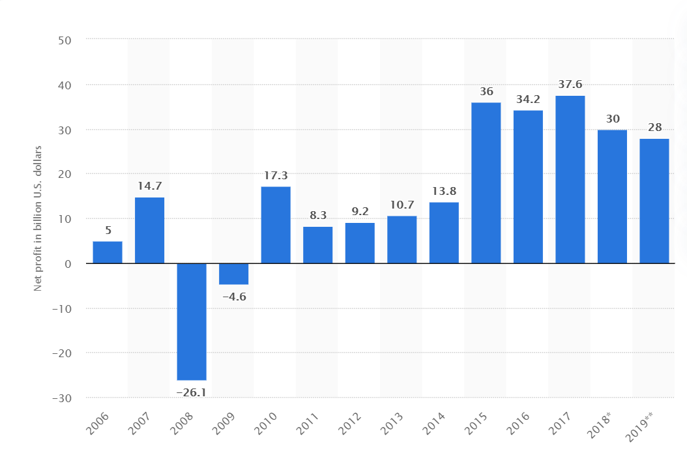
Net profit of commercial airlines worldwide from 2006 - 2019
Source: https://www.statista.com/statistics/232513/net-profit-of-commercial-airlines-worldwide/

Slide 4
Our decision is based on:
Investment and revenue
Top destinations (visitors per year)
Number of destinations from and to an airport

Slide 5
Our Investment
Investing on an airline has many costs and implications:
Small jet (Boeing 737) - $50 million
Large jet (Airbus 380) - $300 million
A pilot with 10 years of experience earns $100.000/year
Smaller airlines spend on fuel an average of $ 100 million/year
and many others...
Sources :https://money.howstuffworks.com/personal-finance/budgeting/budget-airline1.htm
https://www.transtats.bts.gov/fuel.asp?pn=1

Slide 6
Our Cost estimate for 2020
$550 million - Airplane fleet (6 aircrafts)
$1 million - 12 pilots and co-pilots
$75 million - Fuel costs
$3 million - Other operation costs
Total main costs = $79 million
(not considering initial cost with fleet)

Slide 7
Our Revenue estimate for 2020
5 Boeing 737 x 180 capacity x 0.8 Occupation x $85 x 2 times per day x 300 days = $37 million
1 A380 x 650 capacity x 0.8 Occupation x $500 x 2 times per day x 150 days = $78 million
Total revenue = $115 million
Estimated profit = $36 million
Source: https://www.transtats.bts.gov/Data_Elements_Financial.aspx?Data=7

Slide 8
Our target Hub
Medium airline hubs or hub airports used by one or more airlines to concentrate passenger (2-8 Million) traffic and flight operations at a given airport.
Source: https://en.wikipedia.org/wiki/Airline_hub

Slide 9
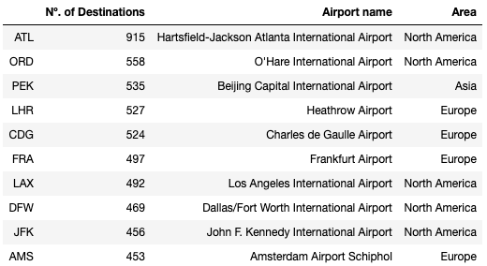
TOP 10 Airport destinations
Airports with higher number of destinations are located in United States
Beijing is leading in Asia
London Heathrow is leader for number of destinations in Europe

Slide 10
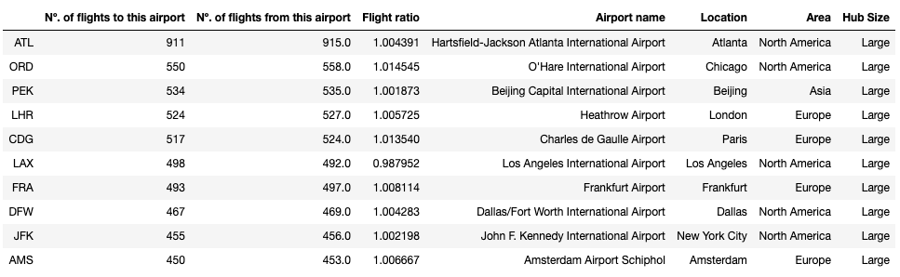
Where should we base our airline?

Slide 11
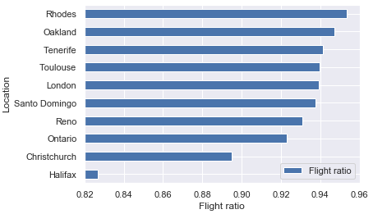
Flight Ratio Analysis

Slide 12
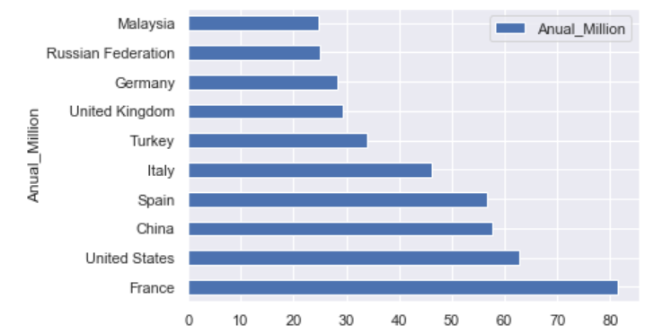
Most Popular Countries in the World
Source: https://www.movehub.com/blog/popular-countries-map/

Slide 13
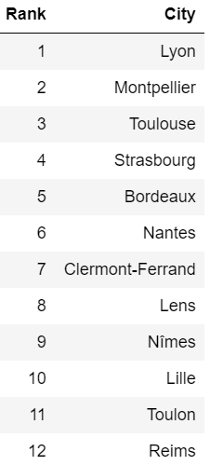



Most popular Cities in France (Paris excluded)
https://www.telegraph.co.uk/travel/destinations/

Slide 14
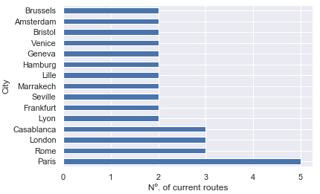
Current Toulouse routes per destination

Slide 15
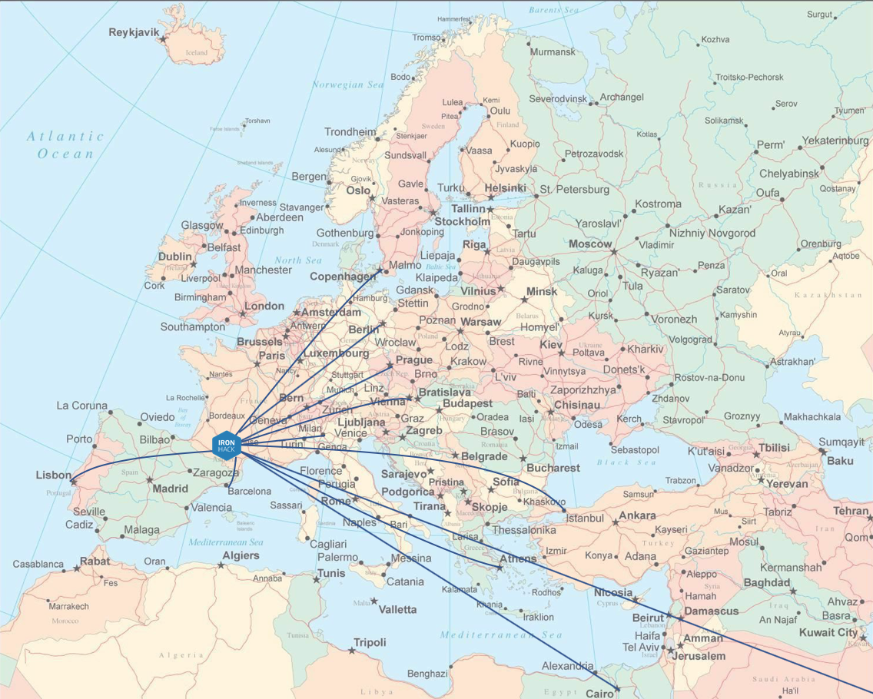
Ironhack Airlines route map
Athens | Copenhagen | Prague
4 794 400 | 5 976 900 | 8 806 700
Lisbon | Vienna | Cairo
4 410 000 | 6 067 100 | 4 388 600
Milan | Barcelona | Berlin
6 347 900 | 6 530 100 | 5 627 400
Dubai |  | Istanbul
15 790 000 |  | 10 730 300

Slide 16
Our Challenges
Finding relevant questions
Focusing on one strategy
Finding the right data
Combine our analysis
Our conclusion

Slide 17
Any Doubts or Questions ?

Slide 19
Our Data
Transportation Statistics online (open sources)
Online Research and Web-Scraping
Datasets of Interest:
Amount of flights per year/day
Amount of passengers
Money involved
Top airlines
Hub size

